Slide 1
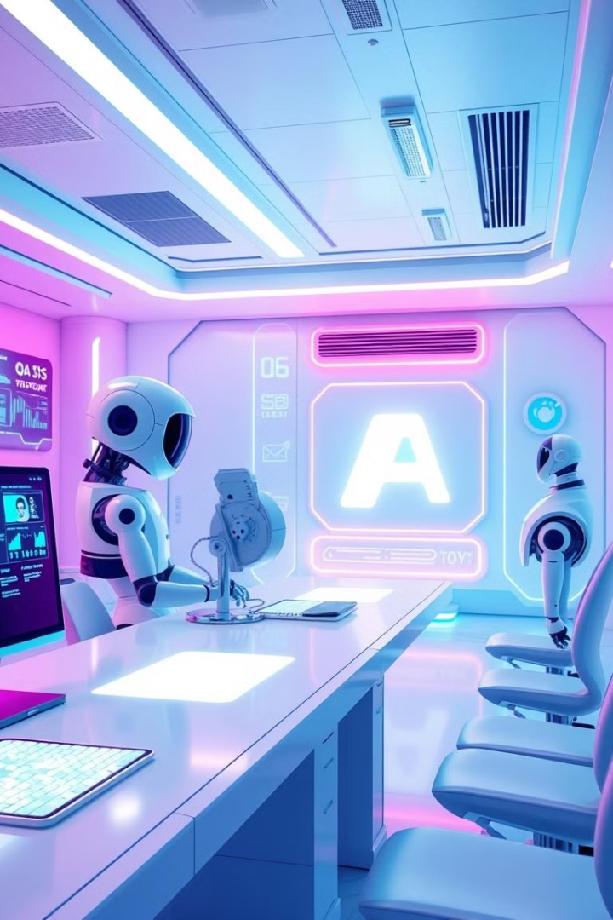
AI-Powered QE Automation: Amazon Q & Custom Framework
Revolutionizing QE with AI for manual and automation, custom agents, and seamless framework integration.
Enhance efficiency, accuracy, and collaboration in the testing lifecycle.
Notes:
always wondered: how to have a smart assistant that can support our repetitive tasks That's why I came up with the idea to implement automation for some repetitive tasks

Slide 2

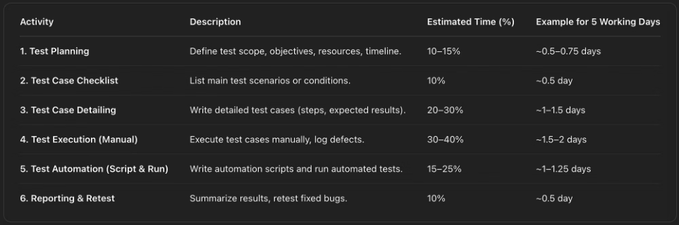
Identify areas for improvement
Notes:
paint points:

Slide 3

The new CB QE Vision
QE Innovation
Enhanced Efficiency
Enhance visibility and interaction
Streamlining test processes
Harness the power of AI
Custom agent solution with mini tools
Notes:
paint points:

Slide 4





Agent: Core Capabilities
Test Checklists
qTest - Test Cases
Knowledge Base
Doc Links
Agent supports checklist creation, automates manual test case generation, answers questions, and suggests useful document links.
Notes:
Will have a demo for this point

Slide 5

Agent: Advanced Automation
Test Case IDs
Source Project
Drive test automation
Context aware generation
Reduced Effort
Seamless integration
Agent auto-generates automation test cases using Project source code and Test Case from qTest. Effort is reduced with context-aware automation.

Slide 6
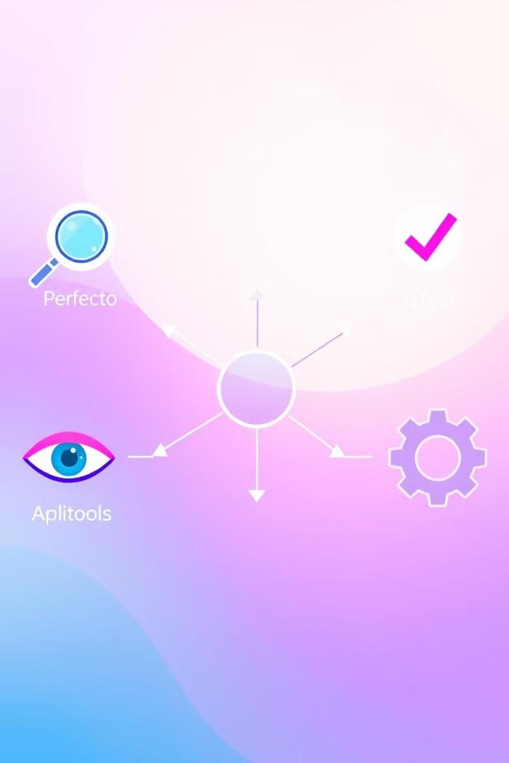



Framework Integration
Perfecto
qTest
Applitools
Custom framework integrates Perfecto, qTest, and Applitools with real-time test execution and result updates.

Slide 7





Workflow: Agent in Action
Generate checklist with team
Auto-create manual cases
Suggest resources
Generate automated test
Run tests; update results

Slide 8

Delivering Measurable Value
30%
15%
30%
Time Savings
Higher Consistency
Time Savings
Test case creation
AI generated tests
Test script creation
Significant time saved, higher accuracy with AI, improved collaboration, and full integration with tools.

Slide 9

Future Roadmap
Platform Support
Extend agent integrations
Knowledge
Enrich domain-specific data
Automation Logic
Complex test scenarios
Future goals: Platform expansion, Knowledge enrichment, and advanced test scenarios.

Slide 10

Questions & Answers
Thank you! Let's discuss how we can evolve this solution together.

